Slide 1


Indian Institute of Information Technology, Sonepat
Minor Project Presentation

Slide 2

PRESENTATION ON JAUNPUR Real Estates Machine Learning Project
UNDER GUIDEANCE OF :
DR. BHOOPESH BHATI &
MR. ROHIT PRATAP SINGH
(Assistant Professor , IIIT Sonipat)
PRESENTED BY:
AMAR NATH PRAJAPATI
12011051_CSE

Slide 3
Jaunpur Real Estates
Aim
To Develop a machine learning based house price predictor which can predict house price as per data of house’s features.
To Develop a website for a Hypothetical Company “JAUNPUR Real Estates” and integrate House Price Predictor with that so that revenue of company can be increased

Slide 4
Objective of The Project
To provide accurate prediction of house’ price on the basis of features of house
To Handle any missing data with imputer techniques
To Create a pipeline for the data so that data will come in standard format automatically.
To select a best predictor model according to features so that standard deviation should be low.

Slide 5
Objective of The Project
To Develop a website for company so that customer can easily connect with company
To Provide a dashboard so that owner can see customer as well as prediction details
To Provide access of dashboard to only company owner
To Provide security of customer’s data who have submitted contact form successfully.

Slide 6
About The Project
Duration
approx 3 month (Feb 2023 – Apr 2023)
Machine Learning Model
Random Forest Regressor
Data Set
UCI ( University of California, Irvine) Housing Dataset
Software Development Model
Incremental Process Model integrated with Agile methodology

Slide 7






Frontend Technologies

Slide 8





Backend Technologies

Slide 9






Data Analytics Tools

Slide 10


Other Software and Websites
Some Youtube Channels
CodeWithHarry
Krish Naik
5 Minute Engineering

Slide 11
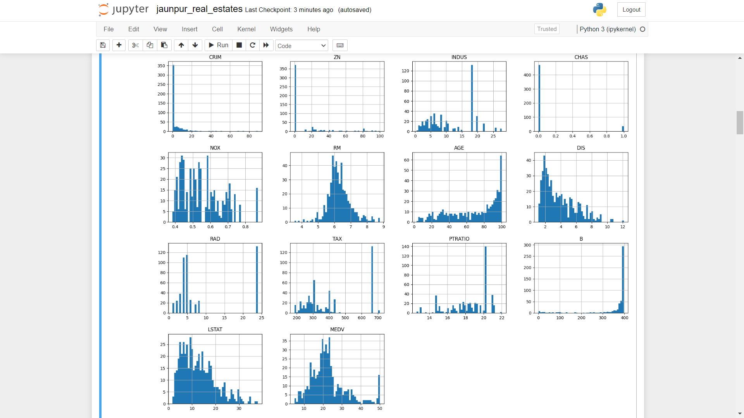
Data Analysis

Slide 12
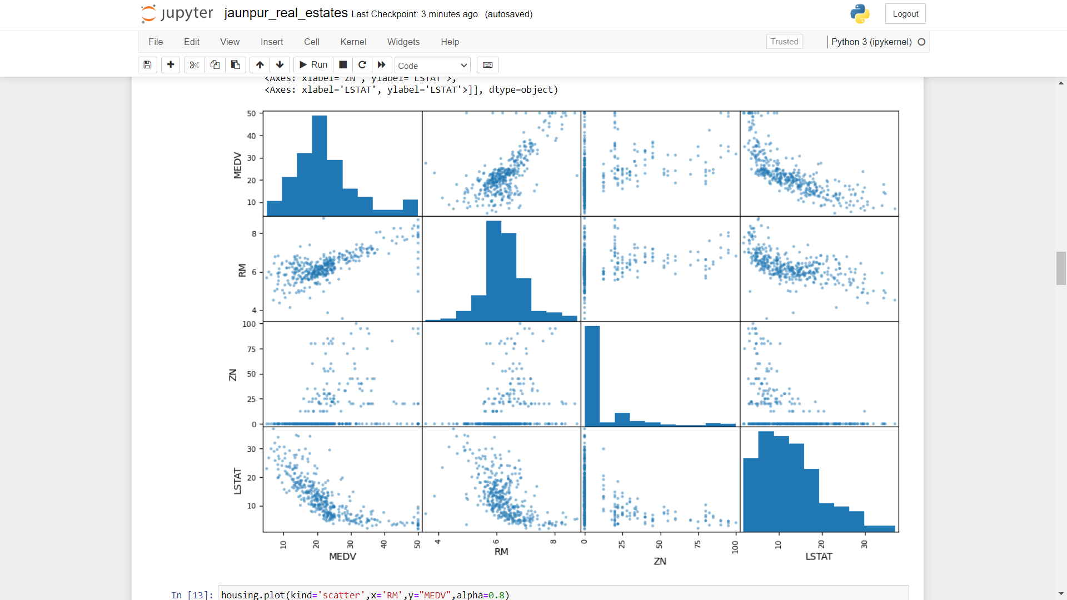
Data Correlation

Slide 13

Home Page

Slide 14
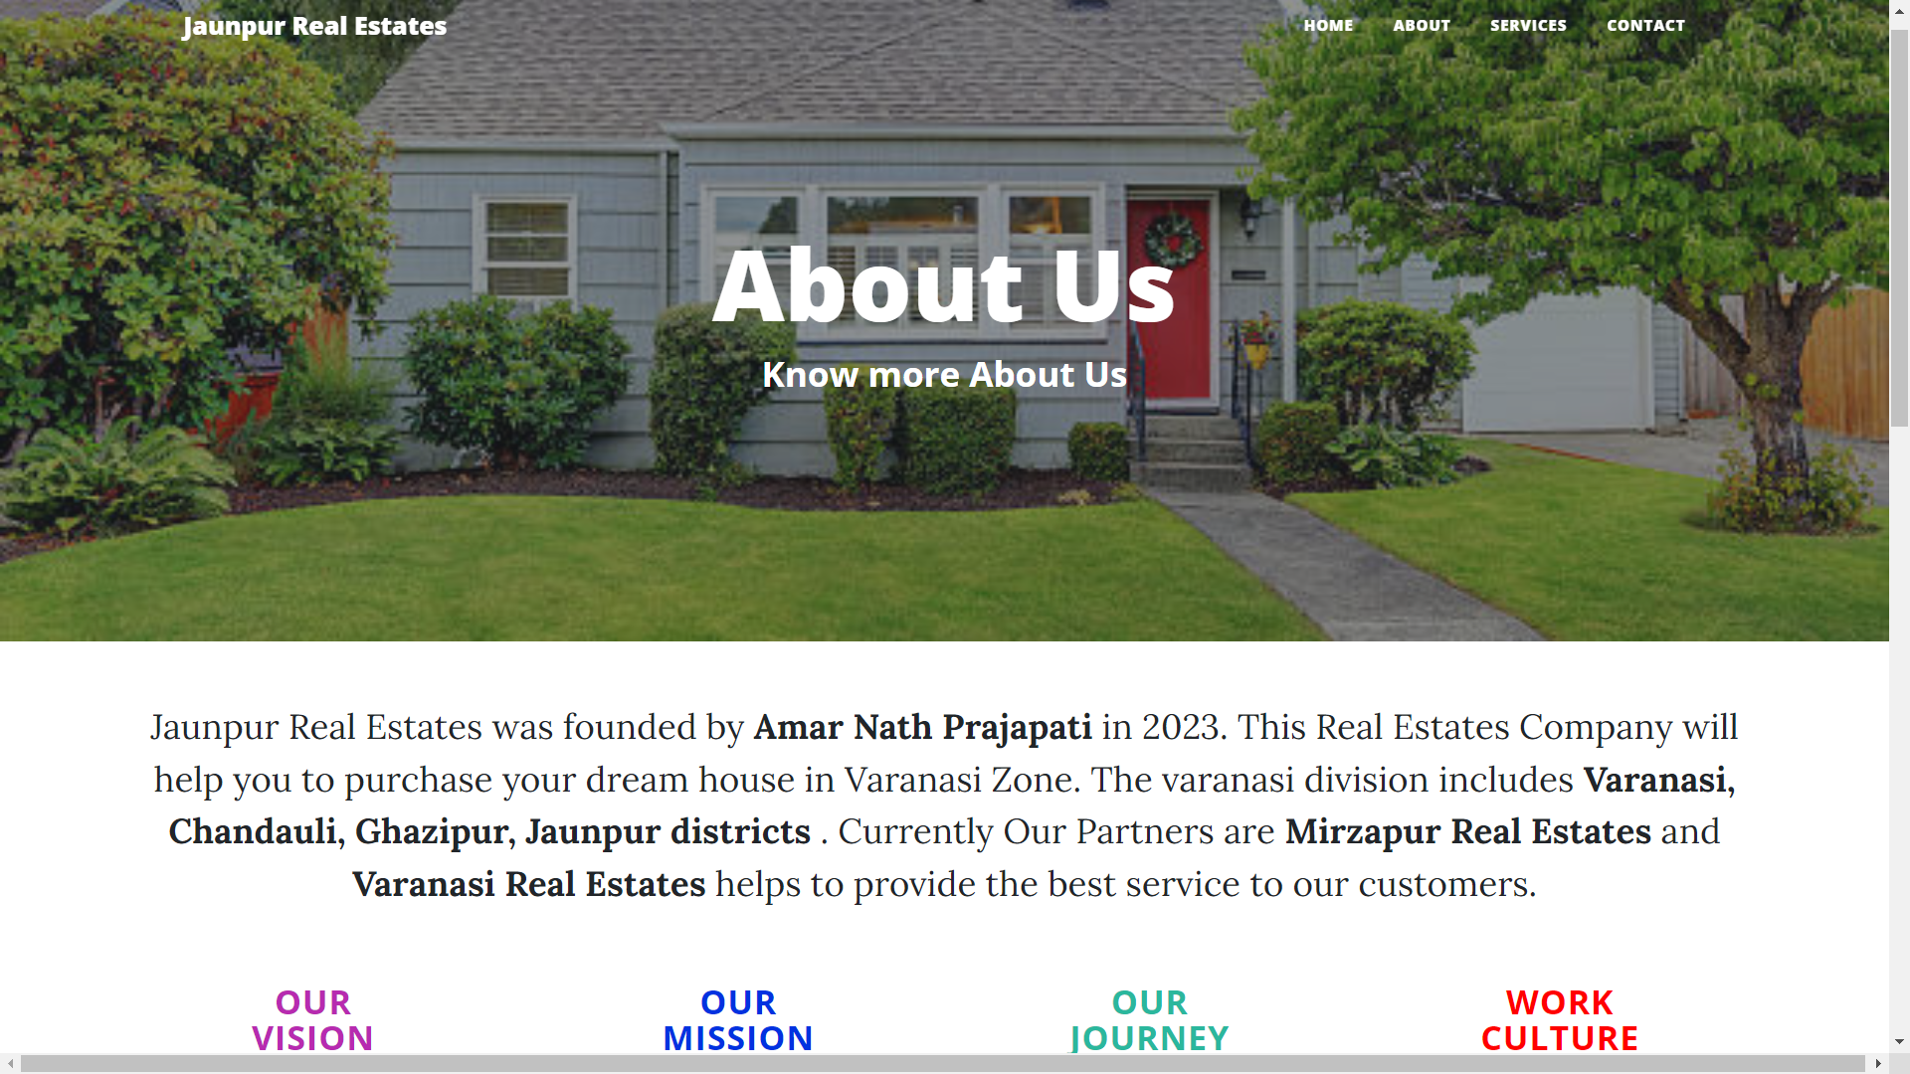
About Page

Slide 15
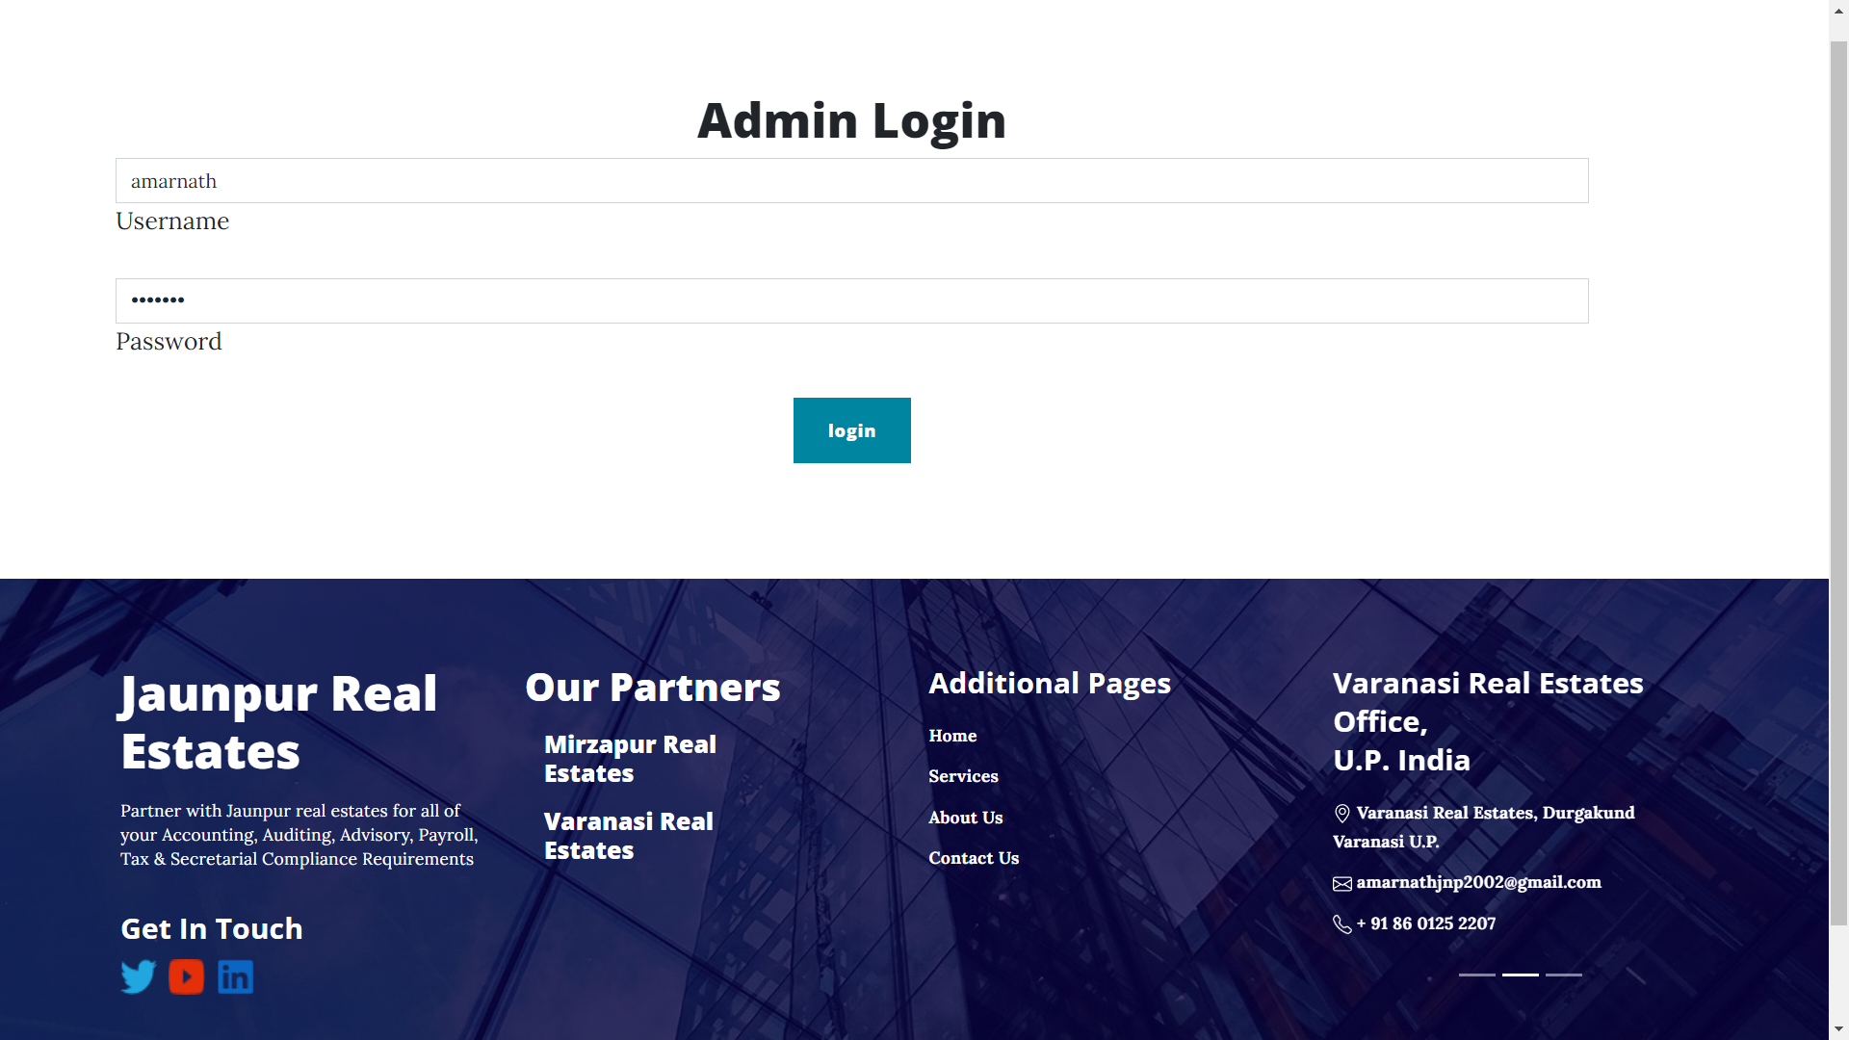
Admin Login Page

Slide 16
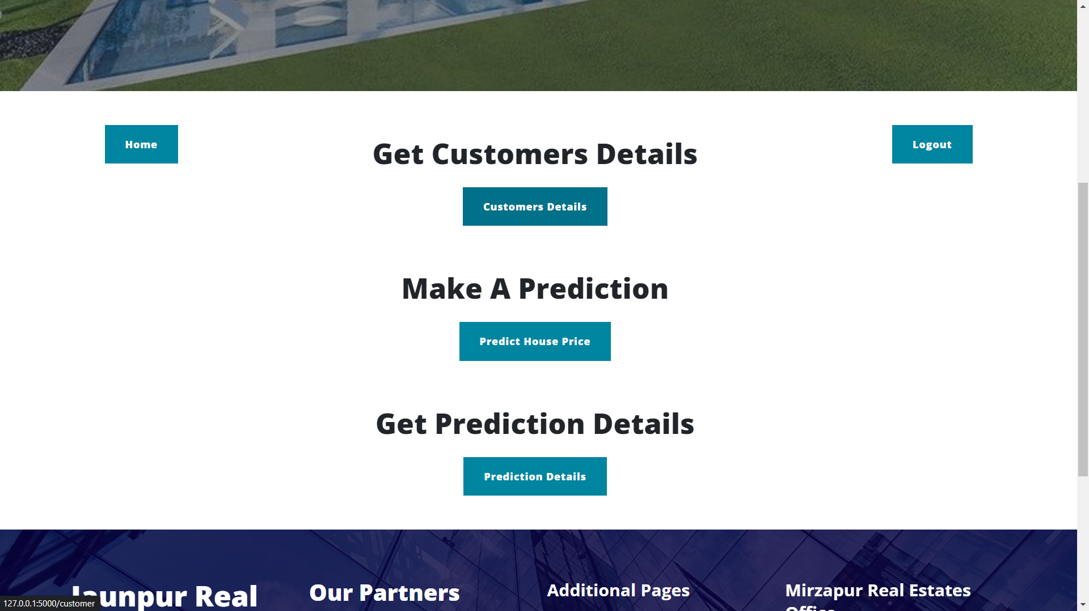
Admin Dashboard

Slide 17
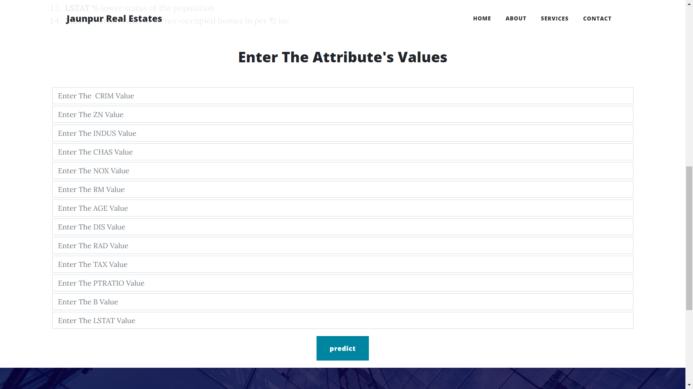
House Prediction Page

Slide 18
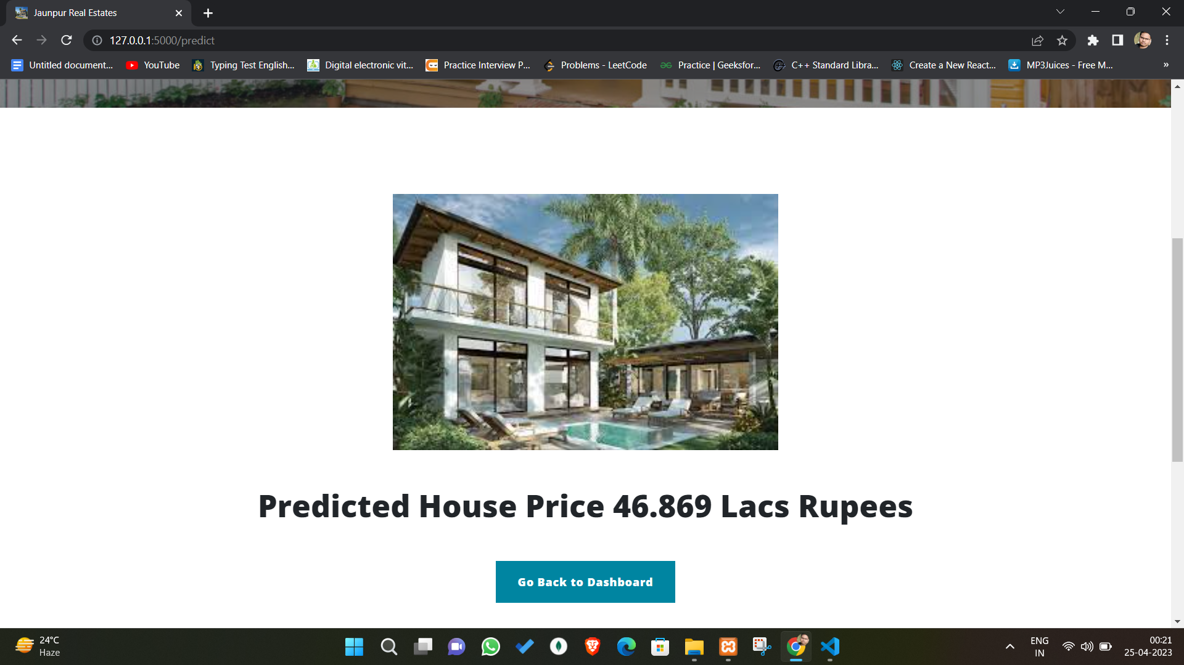
Prediction Result Page

Slide 19
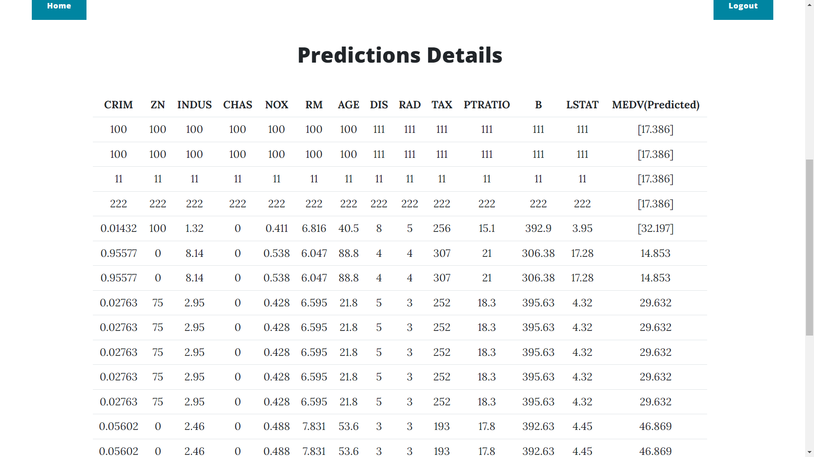
Predicted Value Analysis Page

Slide 20
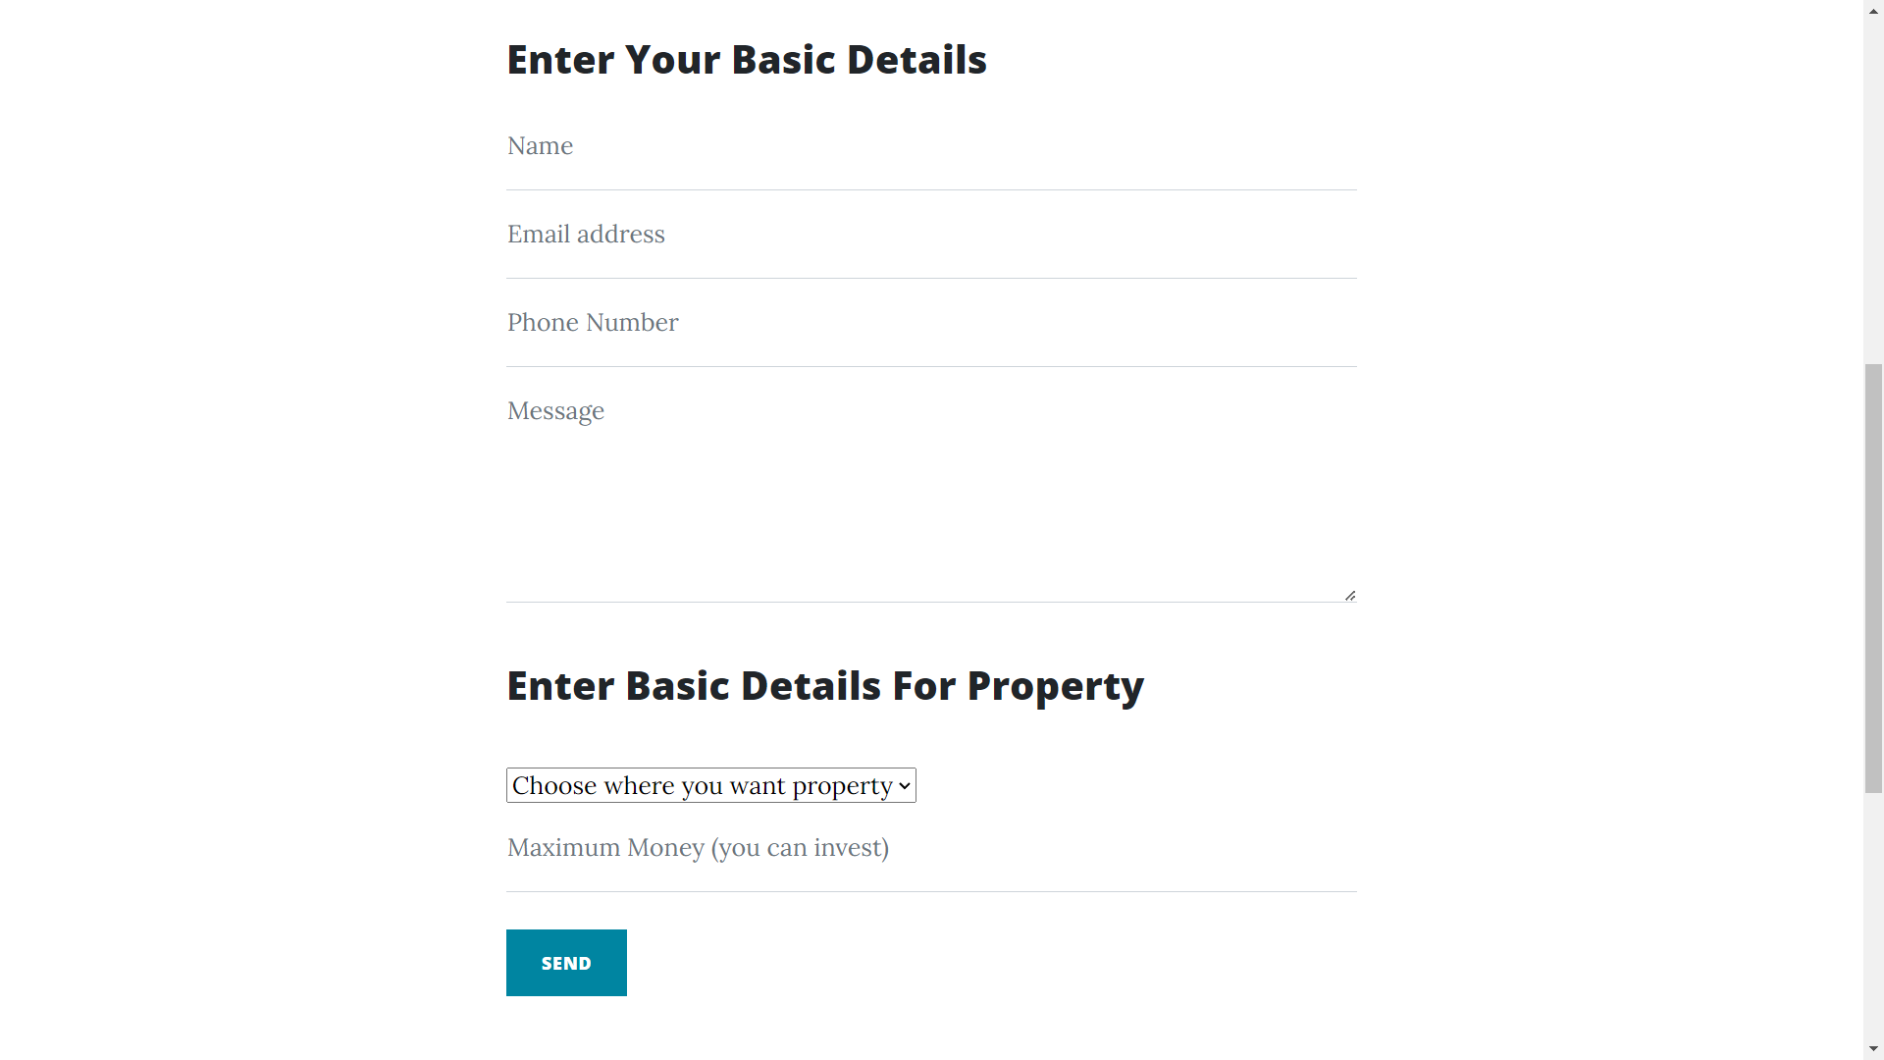
Contact Page

Slide 21
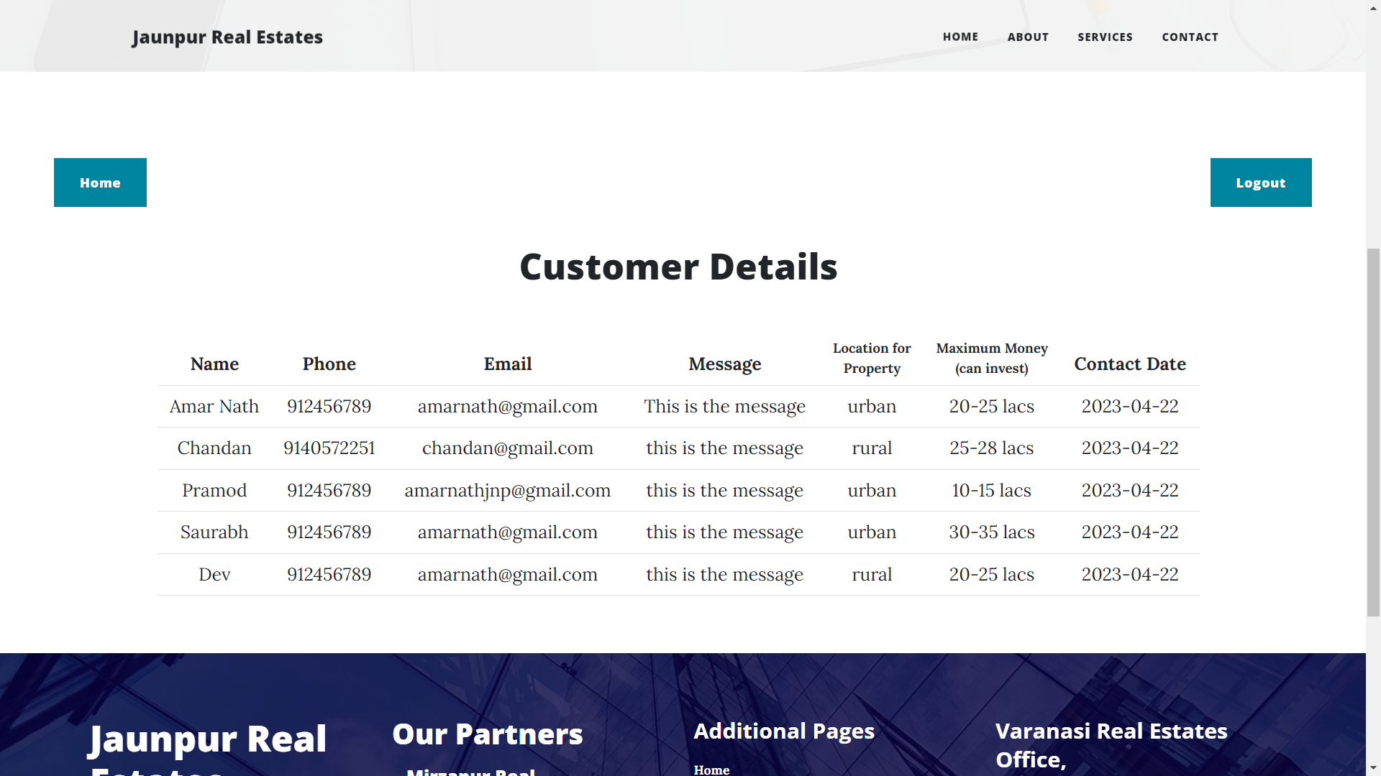
Customer Contact Page

Slide 22
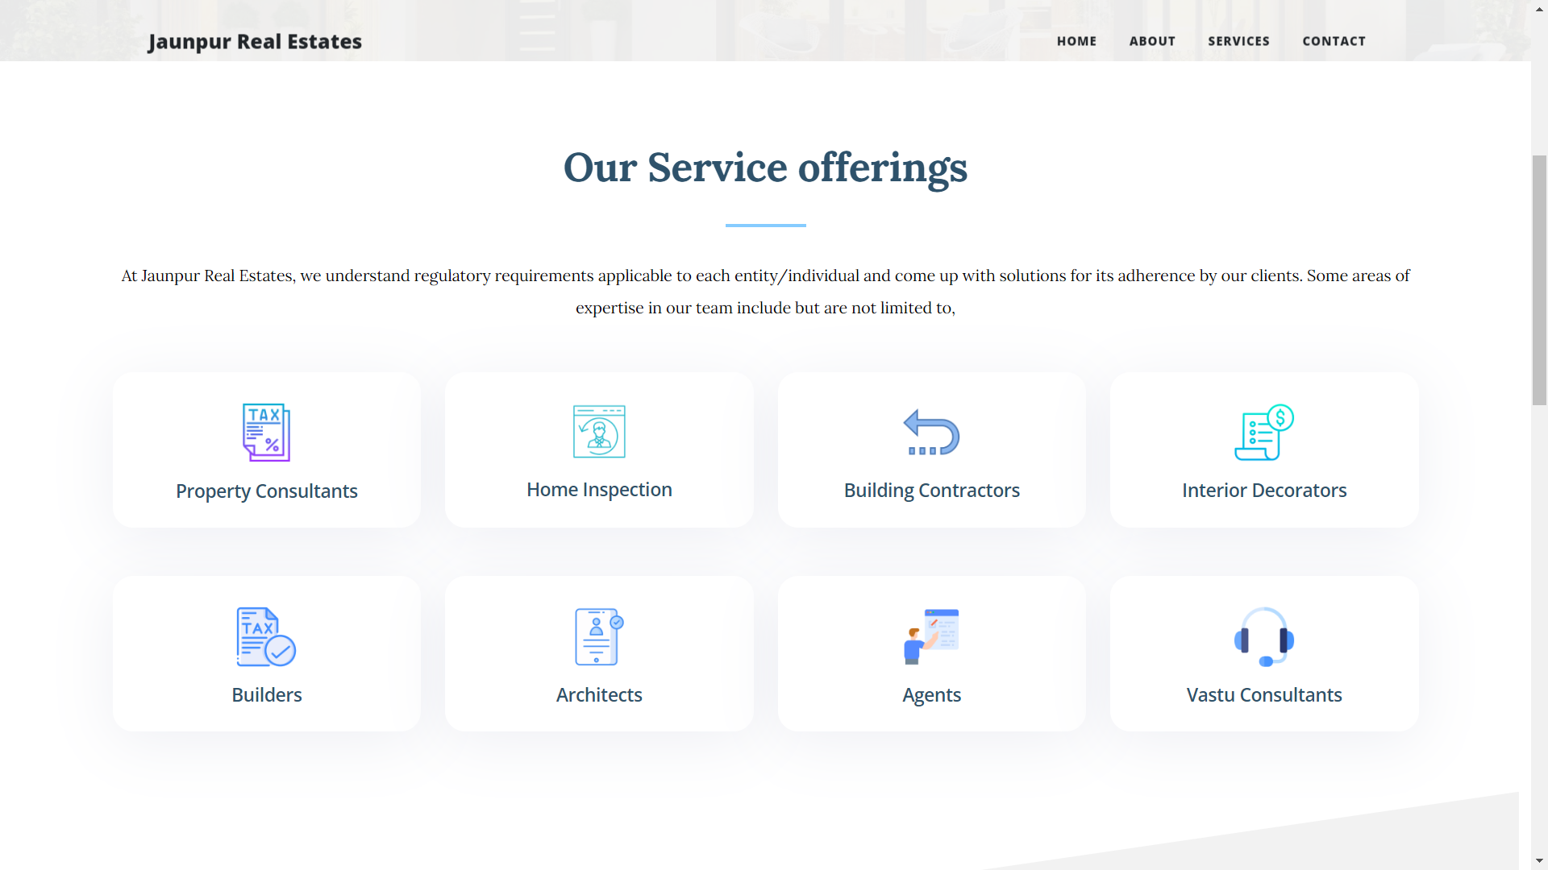
Service Page

Slide 23
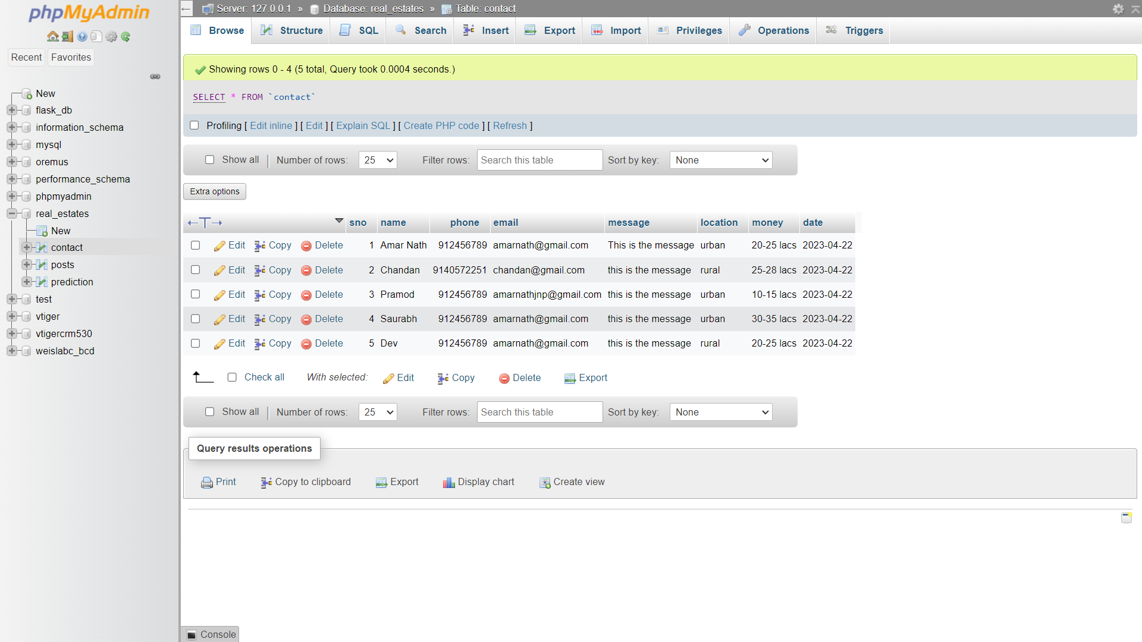
Database

Slide 24
References
1. w3schools. (n.d.). CSS Layout - The z-index Property. Retrieved 02 20, 2023, from CSS Tutorial: https://www.w3schools.com/css/css_z-index.asp
2. W3schools. (n.d.). HTML Responsive Web Design. Retrieved 02 25, 2023, from HTML Tutorial: https://www.w3schools.com/html/html_responsive.asp
3. w3schools. (n.d.). JavaScript Array Methods. Retrieved 3 05, 2023, from JavaScript Tutorial: https://www.w3schools.com/js/js_array_methods.asp
4. Khan, H. (2021, 12 19). CSS Cheat Sheet. Retrieved 04 10, 2023, from codewithharry: https://www.codewithharry.com/blogpost/css-cheatsheet
5. Retrieved 04 10, 2023, from flask Documentation:
https://flask.palletsprojects.com/en/2.2.x/quickstart/
6. Retrieved 04 10, 2023, from Scikit learn Documentaion:
https://scikit-learn.org/stable/modules/cross_validation.html
7. Retrieved 04 10, 2023, from Scikit learn Documentaion:
https://scikit-learn.org/stable/modules/generated/sklearn.ensemble.RandomForestRegressor.html

Slide 25


